Slide 1
Security (and Starting OS/Files)
Discussion Question: What operating system do you use? What is the job of the operating system? (that you think)

Slide 2

SSH – a quick how it works

Slide 3
Why SSH?
We are going to be spending the next few weeks after the midterm
Talking about file systems
Learning Linux
SSH installed on your own machine
Gives you access to CS Machines
You will learn many tools in your CS career
This one is used everywhere!
Let’s look at options.

Slide 4
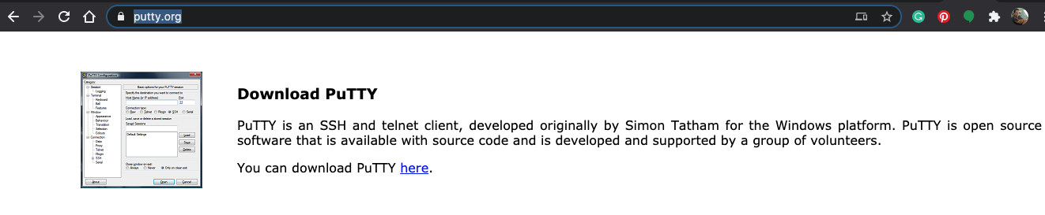
Installing On Local Machine (Client!)
Ask a TA for help installing!
Mac OS / Linux
You already have it. Open up the terminal
To find the terminal type ⌘ + spacebar
Type in “terminal” in the spotlight bar that pops up
Windows
OpenSSH Terminal
Built into Windows 10
type cmd or terminal in the run menu on Windows
type ssh.exe to see if it is enabled
MobaXTerm
Allows easy file transfer between remote and local machine
Allows you to open applications without setting up xterm tunnel
Putty.exe
popular alternative
https://www.putty.org/
download for windows
WSL (Windows Subsystem for Linux)
Simulates Linux on Windows
https://docs.microsoft.com/en-us/windows/wsl/install-win10
Follow manual steps

Slide 5
Connecting To A Server
Any CS machine you have access to
Is a server you can connect to!
https://www.cs.colostate.edu/~info/machines
List of machines. Some popular ones
denver
cheyenne
boston
The machine address is *name*.cs.colostate.edu
denver.cs.colostate.edu
boston.cs.colostate.edu
To connect
> ssh ename@denver.cs.colostate.edu
> ssh ename@boston.cs.colostate.edu
Go ahead and connect to a
CS server now!

Slide 6
Some Commands
ls
Lists the contents of a directory
mkdir cs163
creates a directory cs163
cd cs163
changes your location to be cs163
pwd
present working directory – echos to the terminal which directory you are currently in
nano
Opens a simple text editor (based on pico). You should do this one now
We will go over all these again!!

Slide 7
Coding Practice
> javac HelpSession7.java
compiles your class
> java HelpSession7
runs your java program
Five minutes
in nano
Write a java file from scratch
Call the class HelpSession7
Which means your file name is??
Add a main method
Create a String array, that contains “denver”, “boston”, “portland”
For each item in the array, print with a new line to the screen, the item followed by “cs.colostate.edu”
denver.cs.colostate.edu
boston.cs.colostate.edu
portland.cs.colstate.edu
Work with a partner on finishing it after five minutes
TA will go over solution
And show you how to run it *from the command line*

Slide 8
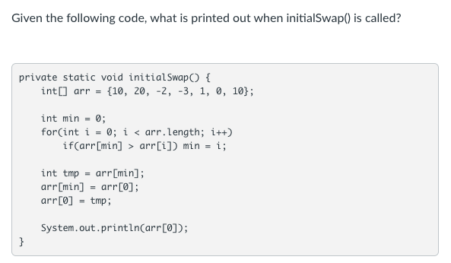
Knowledge Check
Recall – Albert mentioned this example when talking about the steps needed in the farmer-river-crossing riddle!
It takes 3 steps to swap two numbers

Slide 9
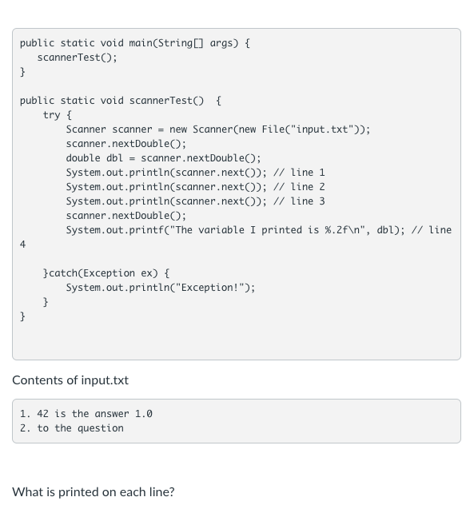
Knowledge Check
Your TA may code this out (or you may!)
Talk it through, draw on paper, whatever you need to
track it.
Notes:
Note: for the coding example to work, you *have* to use a file. You can’t just try it by passing in a string or using System.in – that changes the end of line that a file has.

